Slide 1
CENG 317
Project Name: Lumi Monitor
Final presentation
Abdirashid Yusuf
Link: https:/github.com/Abdirashid-Yusuf/Lumi-monitor

Slide 2
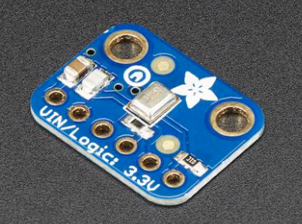
Introduction
Our project is to create a system that monitors the baby while it is sleeping and also senses the condition of the room.
Sensors used
I) TSL2591 Luminosity sensor
II)DHT22 Temperature and Humidity sensor
III) Adafruit I2S MEMS Microphone Breakout - SPH0645LM4H
I am working on the SPH0645LM4H sensor

Slide 3
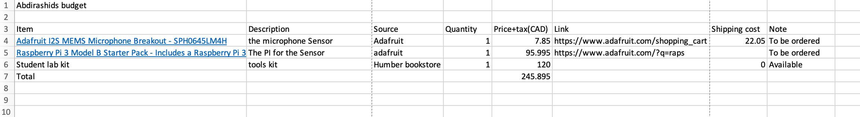
Budget

Slide 4
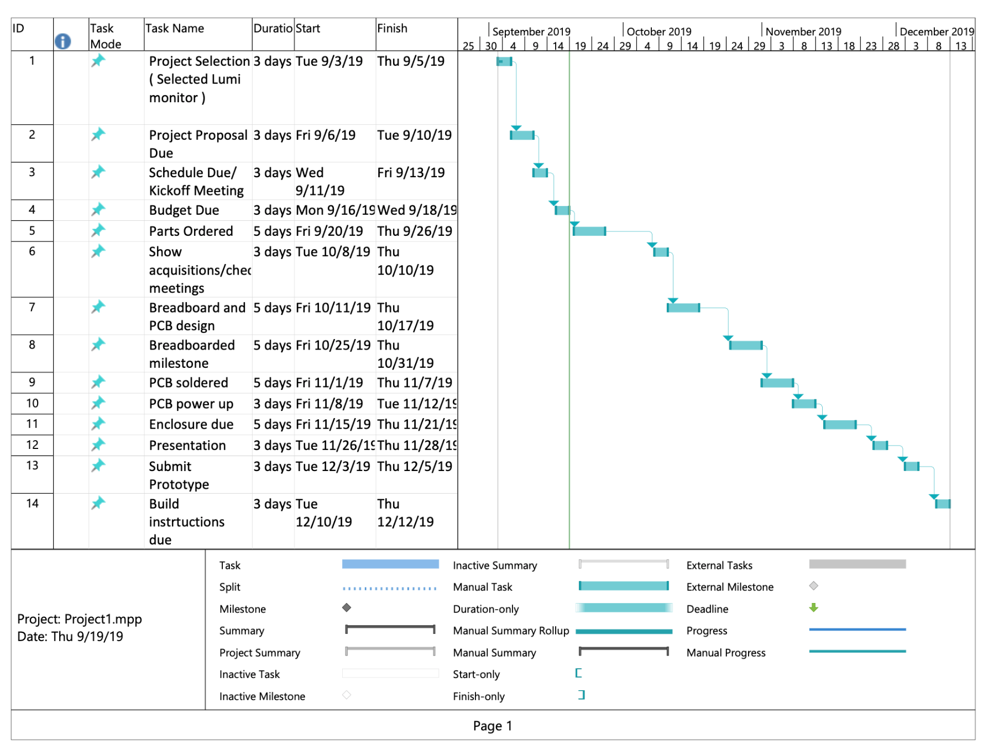
Schedule

Slide 5
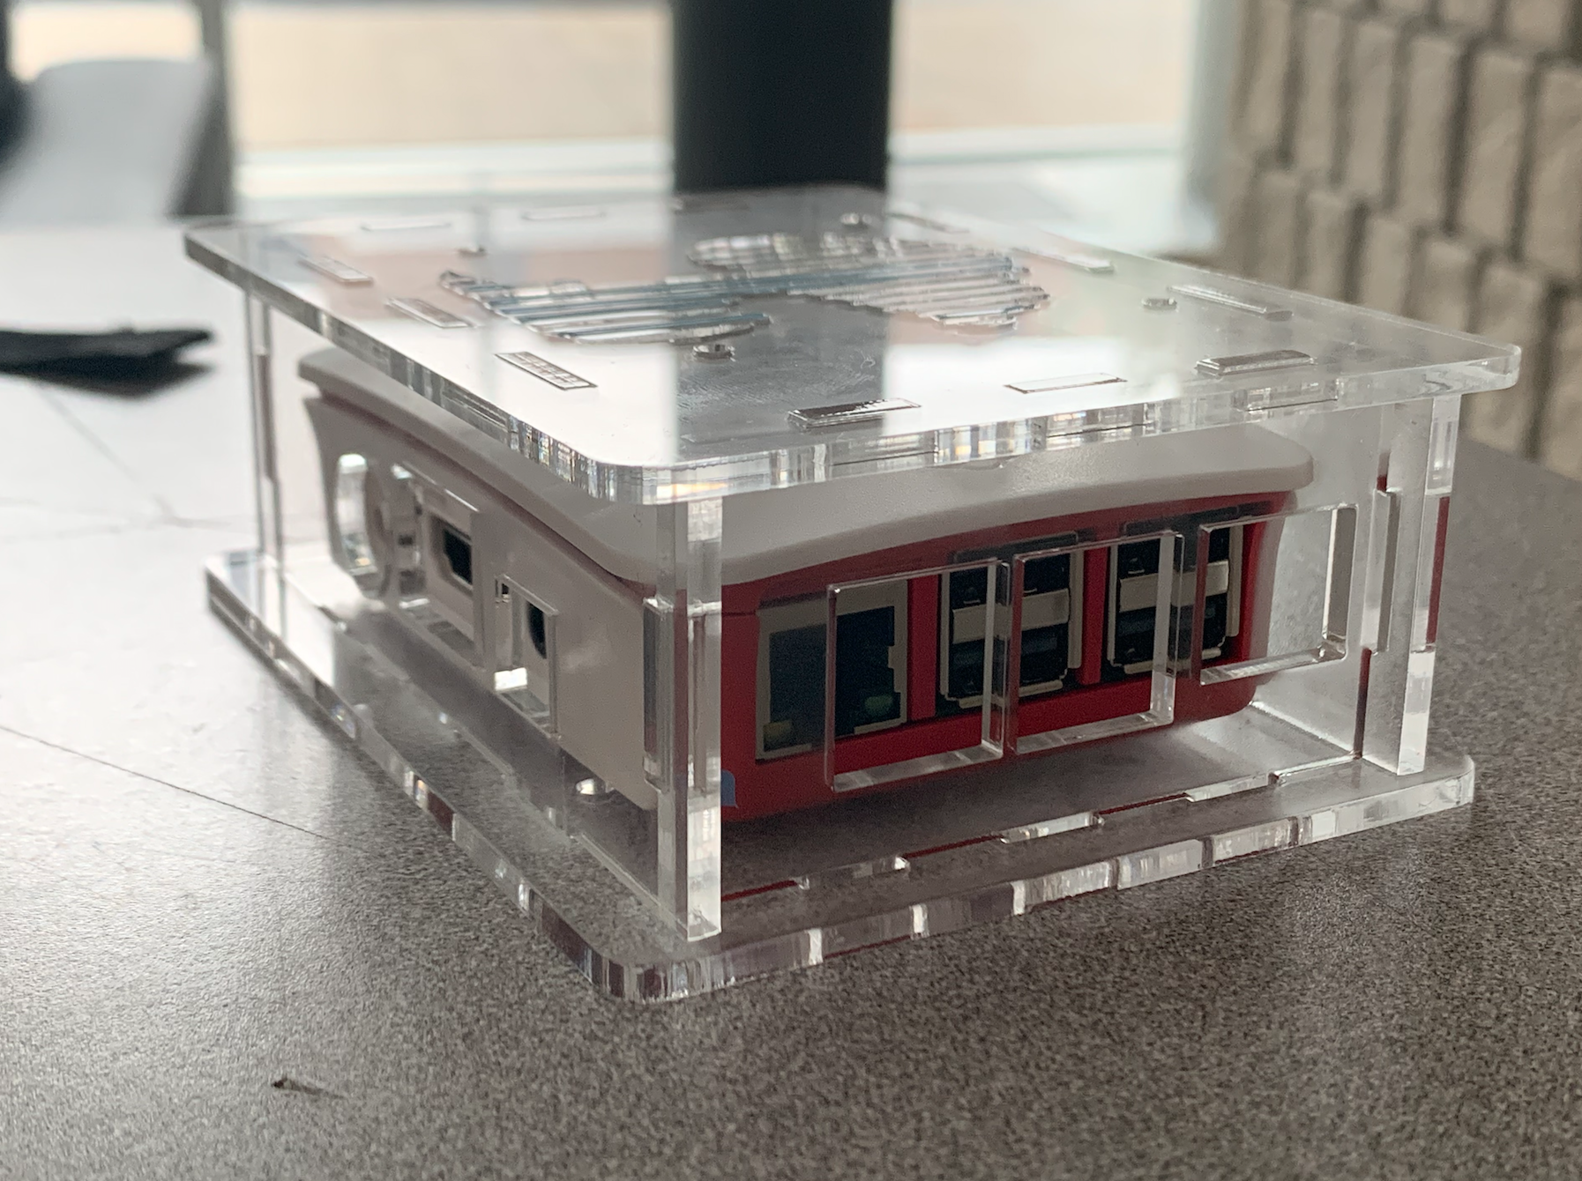
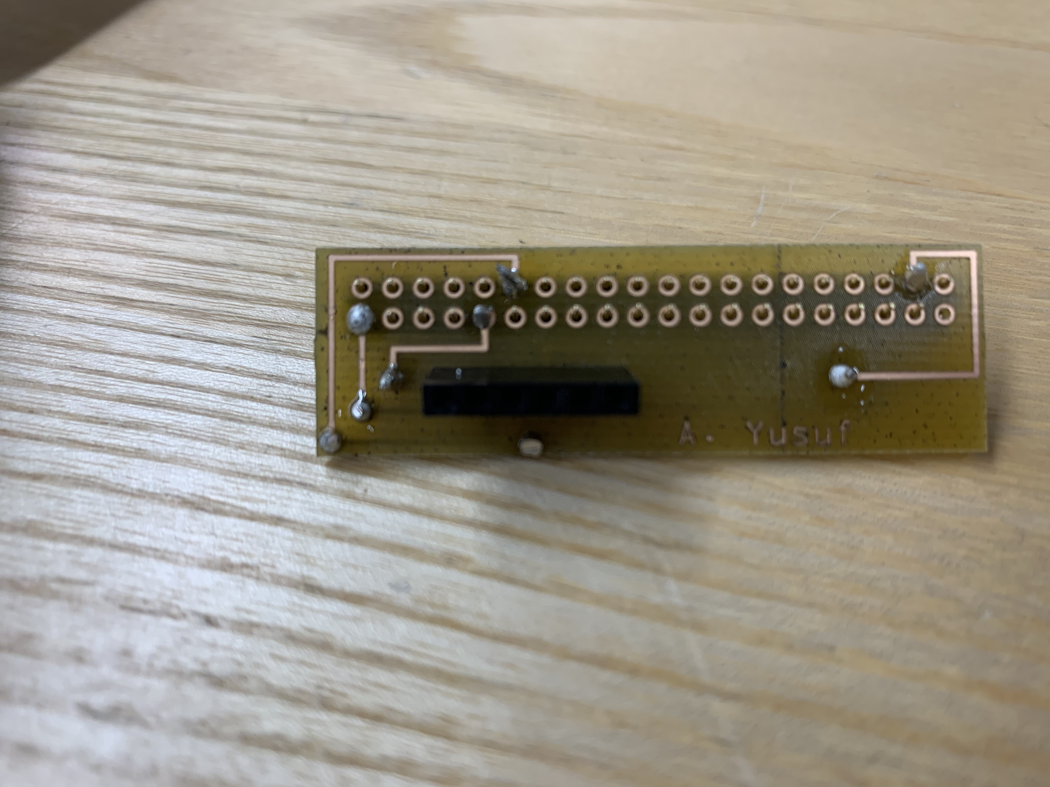
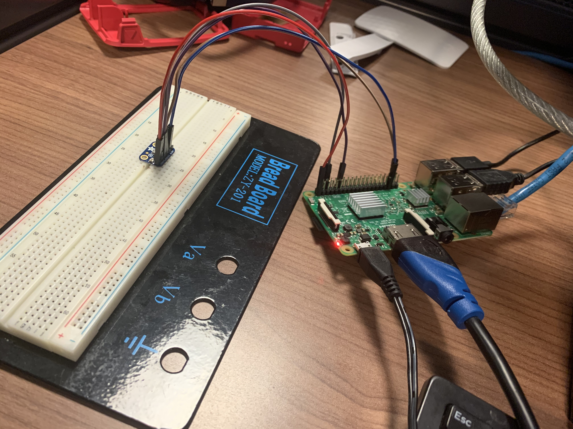
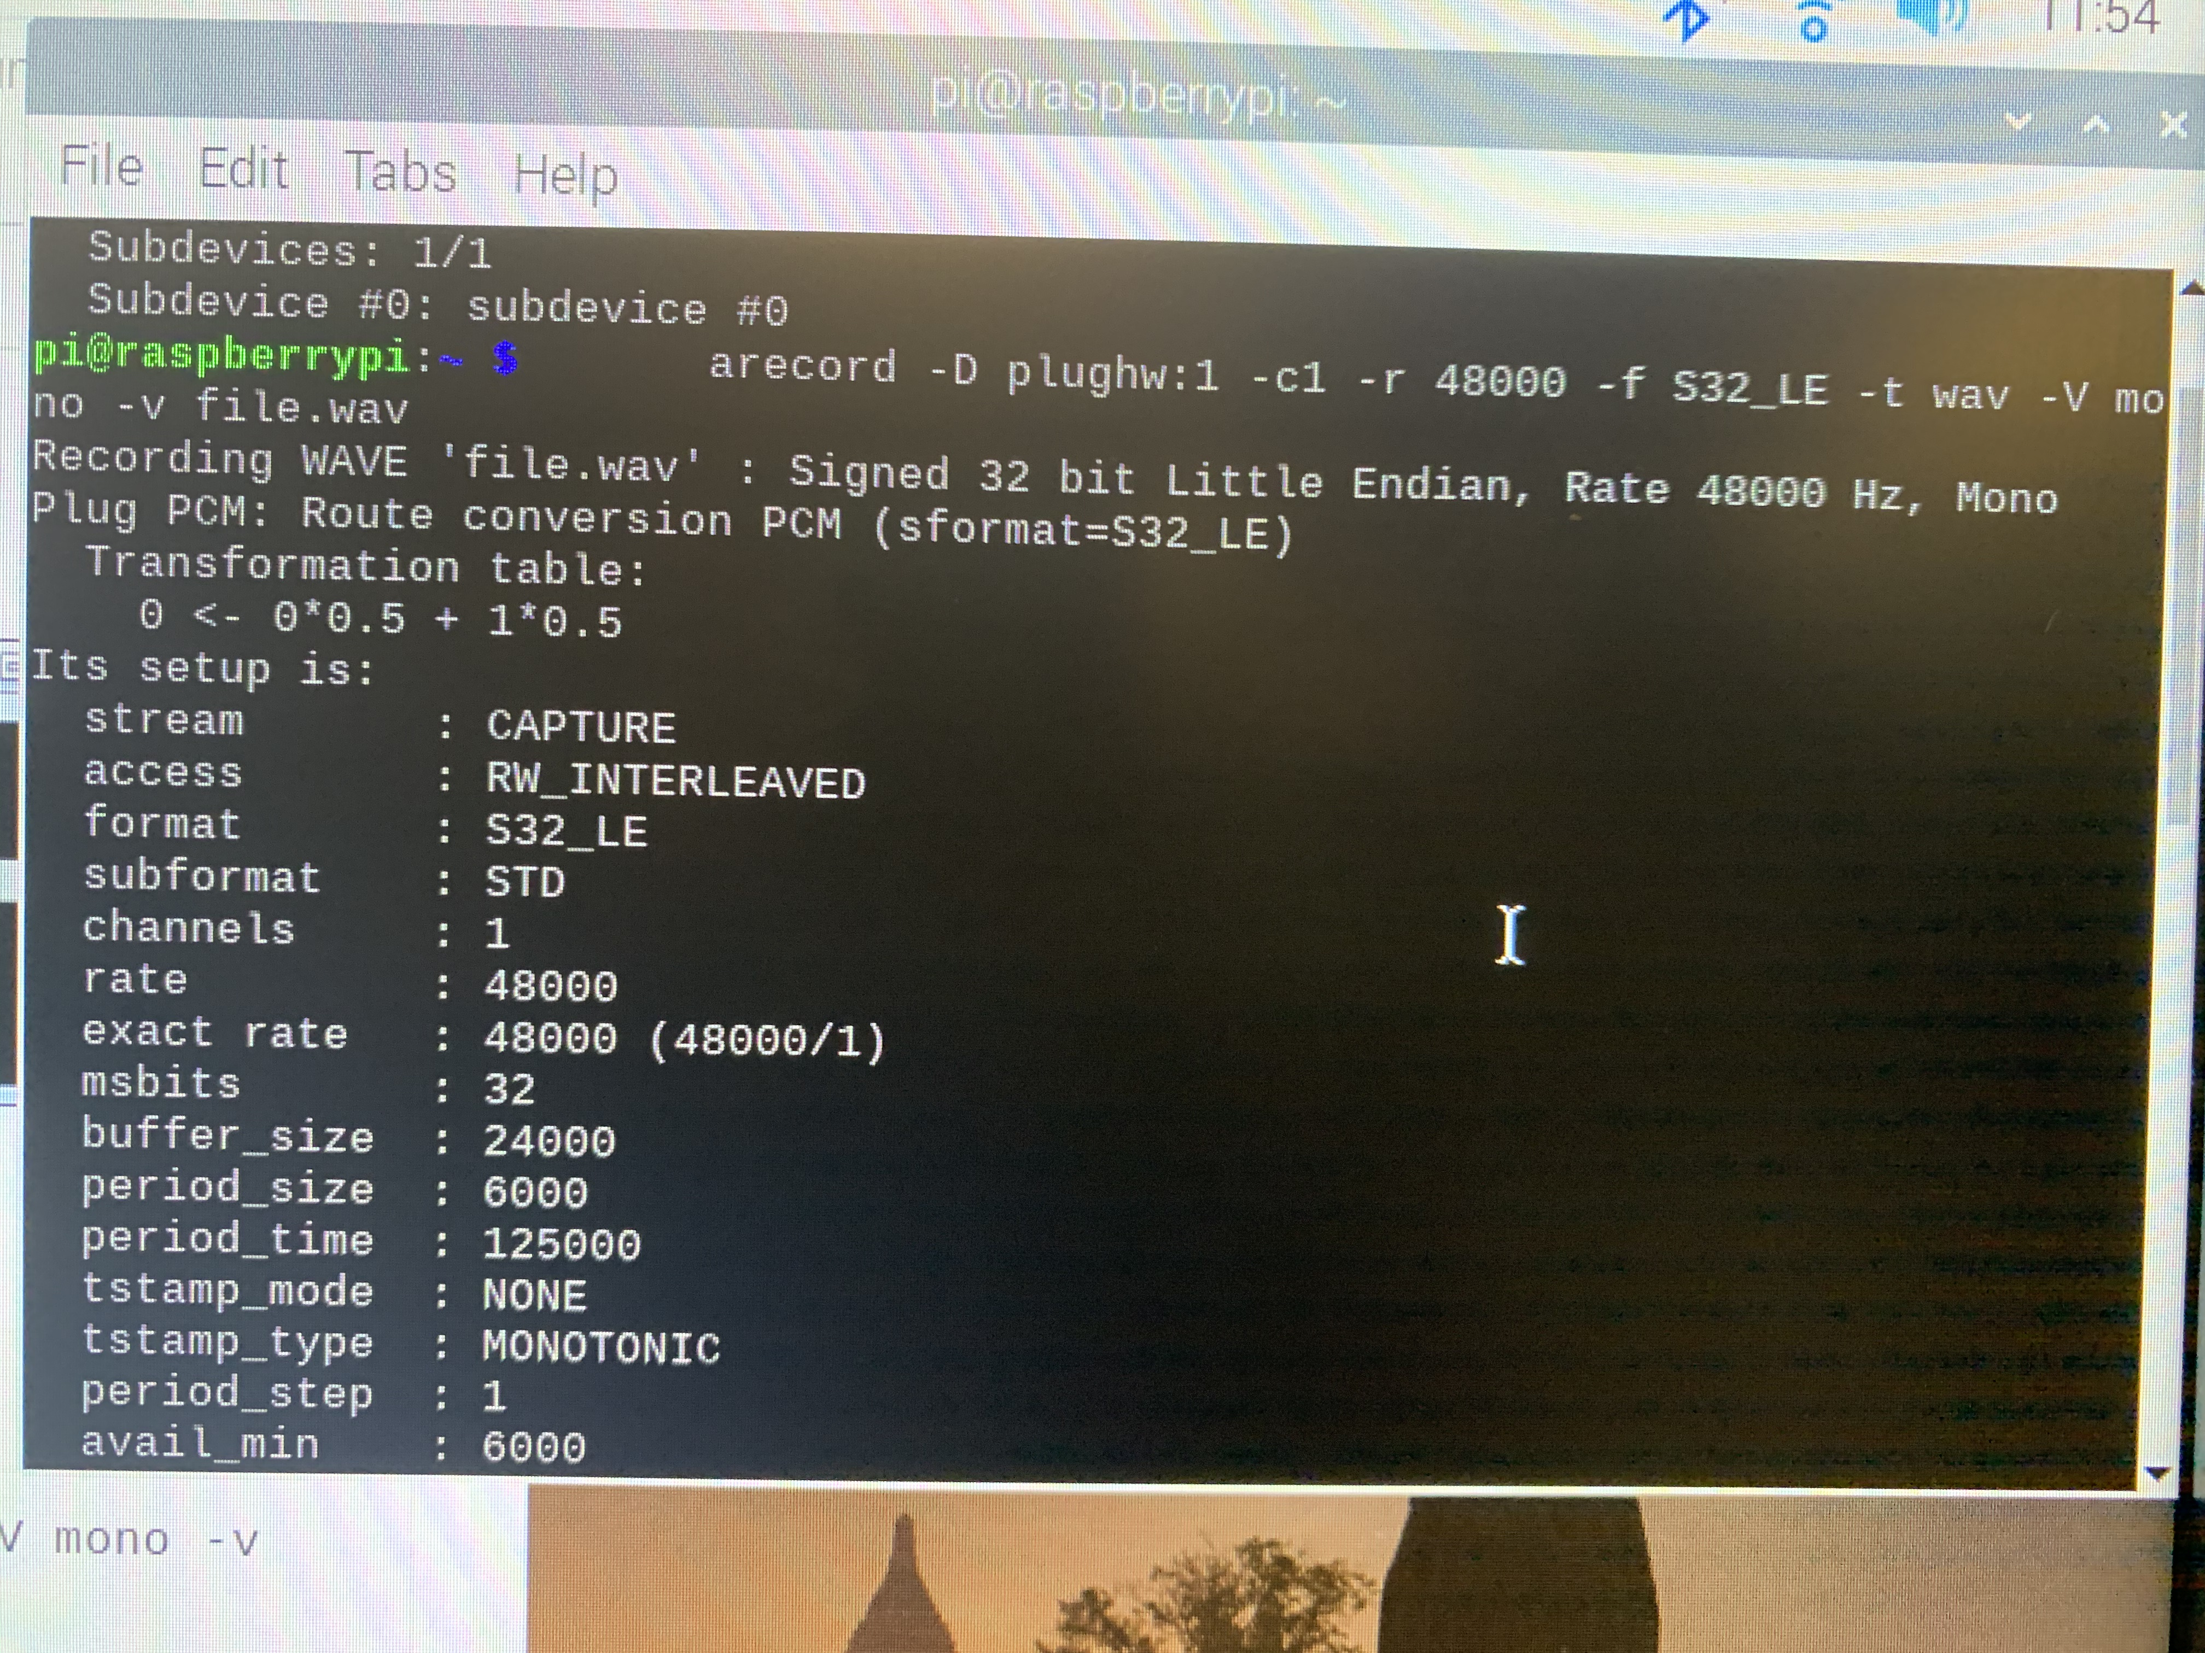
Images
Enclosed Hardware
PCB
Breadboard
Sensor readings

Slide 6
Knowledge from previous classes
TECH 101 Electric Circuits
Basic circuitry is a very essential for this project. This course helped in the design of the schematics.
CENG 216 Intro to Software Engineering
This course helped me in preparing my project schedule using Microsoft project manager.
TECH 103 Technical C
In this course I got familiar with the raspberry pi. I wrote C code on a raspberry pi.
https://learn.adafruit.com/adafruit-i2s-mems-microphone-breakout/raspberry-pi-wiring-and-test

